Slide 1
Nonclassicality, quasiprobabilities and weak values explored in neutron interferometry
Ismaele Vincent Masiello
Neutron and Quantum Physics
Atominstitut
TU Wien, Austria

Slide 2
Neutron Interferometry Group
Yuji Hasegawa (supervisor)
Stephan Sponar (PI)
Hartmut Lemmel (Instrument responsible)
Andreas Dvorak (PhD student)
Florian Engel (PhD student)
Ismaele Vincent Masiello (PhD student)
Kazuma Obigane (PhD student)

Slide 3
Disclaimer
Mainly concepts
Not chronological

Slide 4
Overview
Nonclassicality
Quasiprobabilities and weak values
Experimental results

Slide 5
Preparation and Measurement

Slide 6
Preparation and Measurement
Preparation (P)

Slide 7
Preparation and Measurement
Preparation (P)
System

Slide 8
Preparation and Measurement
Preparation (P)
Measurement (M)
1
2
3
...
n
System

Slide 9
Preparation and Measurement
Preparation (P)
Measurement (M)
1
2
3
t
1
2
3
...
n

Slide 10
Preparation and Measurement
Preparation (P)
Measurement (M)
1
2
3
t
1
2
3
...
n
Outcome probabilities:

Slide 11
Preparation and Measurement
Preparation (Pi)
Measurement (Mj)
1
2
3
t
1
2
3
...
n
P3
M2
M3
P2
...
...
P1
Pr
M1
Mm
Outcome probabilities:

Slide 12
A classical experiment

Slide 13
A classical experiment
Preparation (Pi)
Measurement (Mj)
1
2
3
...
n
P3
System
M3
P2
...
M2
...
P1
Pr
M1
Mm
Defined set of properties:

Slide 14
A classical experiment
Preparation (Pi)
Measurement (Mj)
1
2
3
...
n
P3
M2
M3
P2
...
...
P1
Pr
M1
Mm
Defined set of properties:

Slide 15
A classical experiment
Preparation (Pi)
Measurement (Mj)
1
2
3
...
n
P3
M2
M3
P2
...
...
P1
Pr
M1
Mm
Defined set of properties:

Slide 16
A classical experiment
Preparation (Pi)
Measurement (Mj)
1
2
t
2
3
...
n
P3
System
M3
P2
...
M2
...
P1
Pr
M1
Mm
100%

Slide 17
A classical experiment
Preparation (Pi)
Measurement (Mj)
1
2
3
...
n
100%
P3
M2
M3
P2
...
...
P1
Pr
M1
Mm

Slide 18
A classical experiment
Preparation (Pi)
Measurement (Mj)
1
2
3
t
2
3
...
n
P3
System
M3
P2
...
M2
...
P1
Pr
M1
Mm
75%
25%

Slide 19
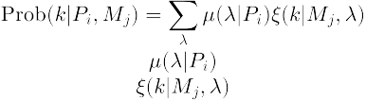
A classical experiment
Probability distribution:
Preparation (Pi)
Measurement (Mj)
1
2
3
t
2
3
...
n
P3
System
M3
P2
...
M2
...
P1
Pr
M1
Mm
75%
25%

Slide 20
A classical experiment
Probability distribution:
Preparation (Pi)
Measurement (Mj)
1
2
3
...
n
25%
75%
P3
System
M3
P2
...
M2
...
P1
Pr
M1
Mm
100%

Slide 21
A classical experiment
Probability distribution:
Response function:
Preparation (Pi)
Measurement (Mj)
1
2
3
...
n
25%
75%
P3
System
M3
P2
...
M2
...
P1
Pr
M1
Mm
100%

Slide 22
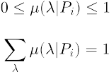
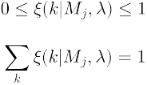
A classical experiment
Probability distribution:
Response function:

Slide 23
A classical experiment
Probability distribution:
Response function:
Outcome probabilities:

Slide 24
A classical experiment
Preparation (P)
Measurement (Mj)
1
2
System
M1
M2
Two properties (shape, color):

Slide 25
A classical experiment
Preparation (P)
Measurement (Mj)
1
2
System
M1
M2
Two properties (shape, color):

Slide 26
A classical experiment
Shape (M1)
Preparation (P)
1
2
1
2
M1
M2
Two properties (shape, color):

Slide 27
A classical experiment
Color (M1)
Preparation (P)
1
2
1
2
M1
M2
Two properties (shape, color):

Slide 28
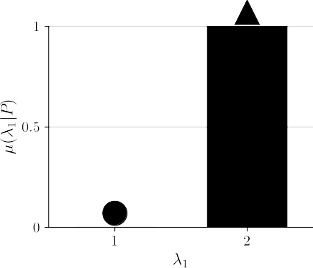
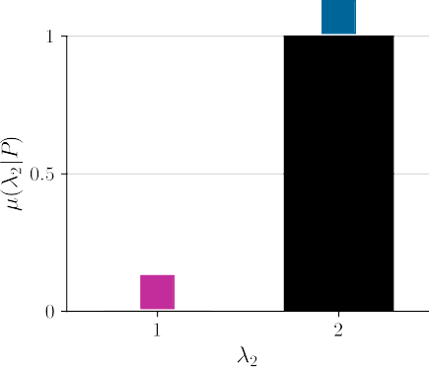
A classical experiment
100%
Outcome probabilities:
100%

Slide 29
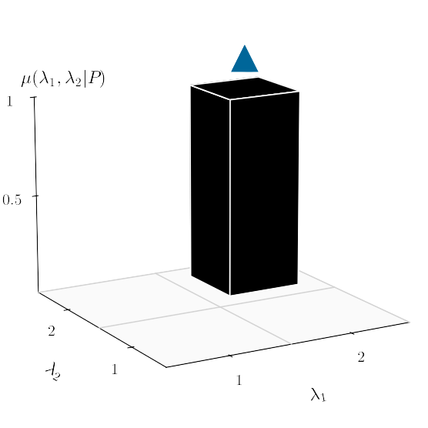
A classical experiment
Probability distribution:

Slide 30
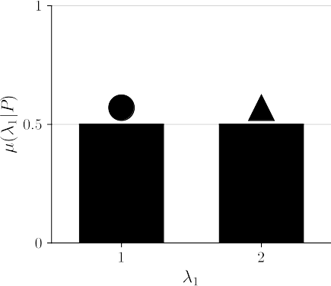
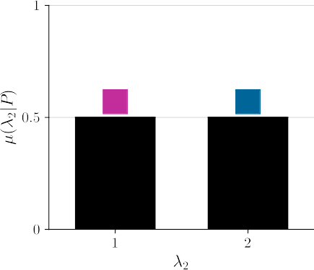
A classical experiment
50%
50%
Outcome probabilities:
50%
50%

Slide 31
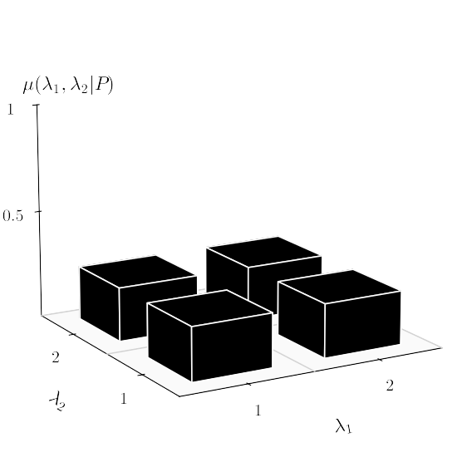
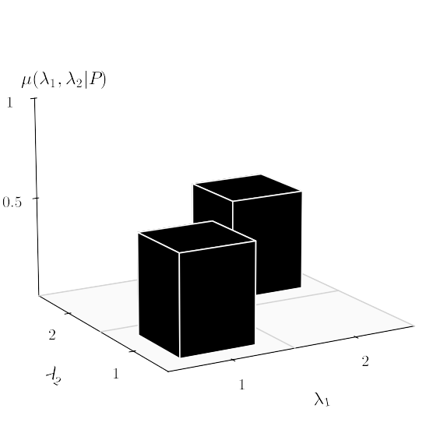
A classical experiment
Probability distribution:

Slide 32
A classical experiment
Sequential (or simultaneous) measurement
1
2
1
2
M1
M2
M1
M2

Slide 33
A classical experiment
Sequential (or simultaneous) measurement
1
2
1
2
M1
M2
M1
M2

Slide 34
A classical experiment
Sequential (or simultaneous) measurement
1
2
1
2
M1
M2
M1
M2
1

Slide 35
A classical experiment
Sequential (or simultaneous) measurement
1
2
1
2
M1
M2
M1
M2
1

Slide 36
A classical experiment
Sequential (or simultaneous) measurement
1
2
1
2
M1
M2
M1
M2
1
2

Slide 37
A classical experiment
Sequential (or simultaneous) measurement
1
2
1
2
M1
M2
M1
M2
1
2
System

Slide 38
A classical experiment
Sequential (or simultaneous) non-disturbing measurement
1
2
1
2
M1
M2
M1
M2
1
2
System

Slide 39
A classical experiment
Outcome probabilities:

Slide 40
A classical experiment
Outcome probabilities for sharp measurements:

Slide 41
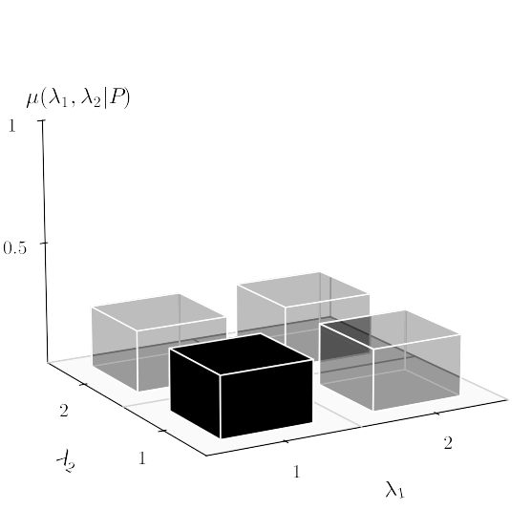
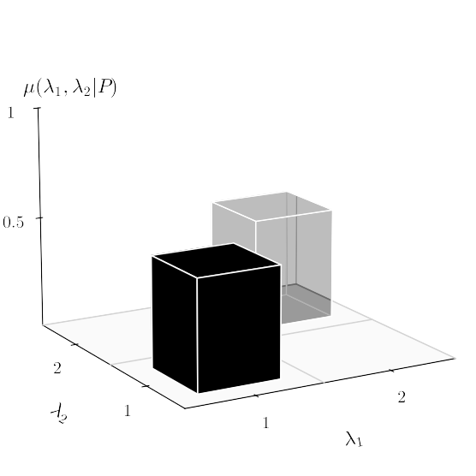
A classical experiment
Outcome probabilities for sharp measurements:

Slide 42

Summary
Probability distribution for P:
Response function for M:
Outcome probabilities:
Outcome probabilities for non-disturbing joint measurements:

Slide 43
A quantum experiment

Slide 44
A quantum experiment
Preparation (Pi)
Measurement (Mj)
1
2
3
...
n
P3
M2
M3
P2
...
...
P1
Pr
M1
Mm

Slide 45


A quantum experiment
Preparation (Pi)
Measurement (Mj)
1
2
3
...
n
P3
System
M3
P2
...
M2
...
P1
Pr
M1
Mm
Set of undefined properties:

Slide 46
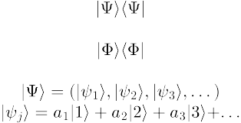
A quantum experiment
Preparation (Pi)
Measurement (Mj)
1
2
3
...
n
P3
System
M3
P2
...
M2
...
P1
Pr
M1
Mm
Set of undefined properties:
Superposition:

Slide 47
A quantum experiment
Pure state:
Preparation (Pi)
Measurement (Mj)
1
2
3
...
n
P3
System
M3
P2
...
M2
...
P1
Pr
M1
Mm
100%

Slide 48
A quantum experiment
Pure state:
Projective measurement:
Preparation (Pi)
Measurement (Mj)
1
2
3
...
n
P3
System
M3
P2
...
M2
...
P1
Pr
M1
Mm
100%

Slide 49
A quantum experiment
Pure state:
Projective measurement:
Preparation (Pi)
Measurement (Mj)
1
2
3
...
n
P3
M2
M3
P2
...
...
P1
Pr
M1
Mm
Outcome probabilities:

Slide 50
A quantum experiment
Pure state:
Projective measurement:
Preparation (Pi)
Measurement (Mj)
1
2
3
...
n
25%
75%
P3
M2
M3
P2
...
...
P1
Pr
M1
Mm
Outcome probabilities:

Slide 51
A quantum experiment
Preparation (Pi)
Measurement (Mj)
1
2
3
...
n
P3
System
M3
P2
...
M2
...
P1
Pr
M1
Mm
75%
25%

Slide 52

A quantum experiment
Density matrix:
Preparation (Pi)
Measurement (Mj)
1
2
3
...
n
P3
System
M3
P2
...
M2
...
P1
Pr
M1
Mm
75%
25%

Slide 53
A quantum experiment
Density matrix:
(mixed state)
Preparation (Pi)
Measurement (Mj)
1
2
3
...
n
P3
System
M3
P2
...
M2
...
P1
Pr
M1
Mm
75%
25%

Slide 54
A quantum experiment
Density matrix:
POVM element:
Preparation (Pi)
Measurement (Mj)
1
2
3
...
n
P3
System
M3
P2
...
M2
...
P1
Pr
M1
Mm
100%

Slide 55
A quantum experiment
Density matrix:
POVM element:
Preparation (Pi)
Measurement (Mj)
1
2
3
...
n
10%
80%
10%
P3
System
M3
P2
...
M2
...
P1
Pr
M1
Mm
100%

Slide 56
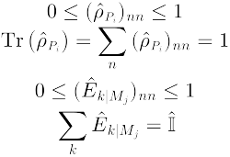
A quantum experiment
Density matrix for P:

Slide 57
A quantum experiment
Density matrix for P:
POVM for M:

Slide 58

A quantum experiment
Density matrix for P:
POVM for M:
Outcome probabilities:

Slide 59
A quantum experiment
Density matrix for P:
POVM for M:
Outcome probabilities:
Outcome probabilities for pure states
and projective measurements:

Slide 60
A quantum experiment
Sequential (or simultaneous) non-disturbing measurement
1
2
1
2
M1
M2
M1
M2

Slide 61

A quantum experiment
Commuting measurements:
Sequential (or simultaneous) non-disturbing measurement
1
2
1
2
M1
M2
M1
M2

Slide 62

A quantum experiment
Commuting measurements:
Sequential (or simultaneous) non-disturbing measurement
1
2
1
2
M1
M2
M1
M2
Outcome probabilities:

Slide 63
A quantum experiment
Density matrix for P:
POVM for M:
Outcome probabilities:
Outcome probabilities for non-disturbing joint measurements:

Slide 64
Is quantum mechanics classical?

Slide 65
Is quantum mechanics classical?
Outcome probabilities:
?

Slide 66
Is quantum mechanics classical?
Outcome probabilities:
?

Slide 67
Is quantum mechanics classical?
M1
M2
Measurements:
M3
M4
1
2
1
2
M1
M2
M3
M4
Outcome probabilities:

Slide 68
Is quantum mechanics classical?
M1
M2
Disturbing
Measurements:
M3
M4
1
2
1
2
M1
M2
M3
M4
Outcome probabilities:

Slide 69
Is quantum mechanics classical?
M1
M2
Disturbing
Measurements:
Non-disturbing
M3
M4
1
2
1
2
M1
M2
M3
M4
Outcome probabilities:

Slide 70
Is quantum mechanics classical?
Outcome probabilities:
?

Slide 71
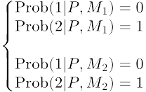
A classical experiment
100%
Outcome probabilities:
100%

Slide 72
A quantum experiment
Pure state:
Projective measurement:
Preparation (Pi)
Measurement (Mj)
1
2
3
...
n
25%
75%
P3
M2
M3
P2
...
...
P1
Pr
M1
Mm
Outcome probabilities:

